Slide 1

Climate Change Gas Emissions Prediction
Group 5
Anh Le | Asad Shaik | Malarvizhi S Pandian | Manobala Purushothaman | Michael Dooley

Slide 2
Table of Contents
Introduction
Problem statement
Data source and description
Data Viz / EDA
Model Evaluation
Results
Recommendations
Predictions using ML models
Time Series Forecasting

Slide 3
Introduction
Climate change is a long-term change in the average weather patterns that have come to define Earth’s local, regional, and global climates.
Most of it is caused due to emission of greenhouse gases which is a result of more fossil consumption by humankind.
The impact of 1.5 degree Celsius of global warming is above pre-industrial level and related global greenhouse gas emission
In this project, only two gases such as CO2 – carbon dioxide and CH4 – Methane is taken into consideration

Slide 4
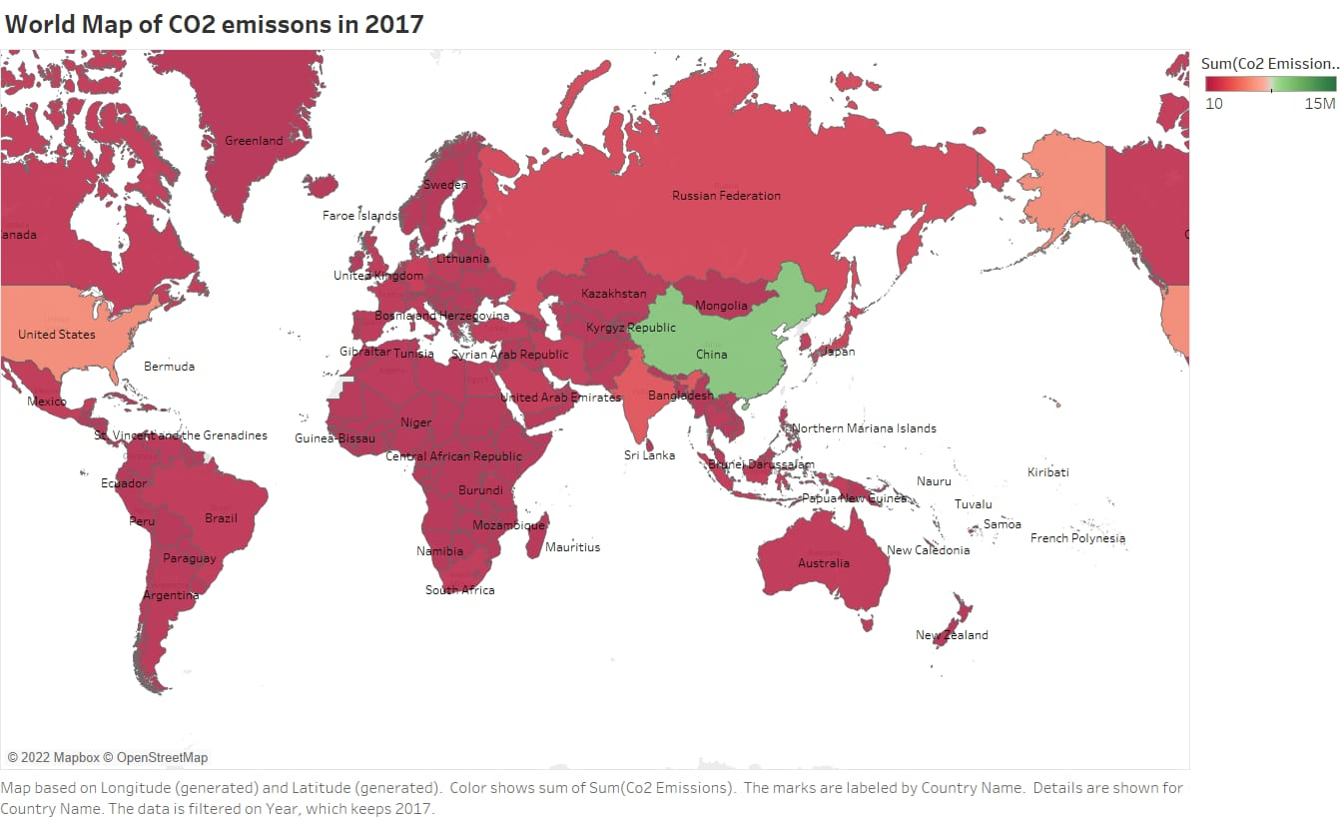
World Map of CO2 emissions in 2017

Slide 5
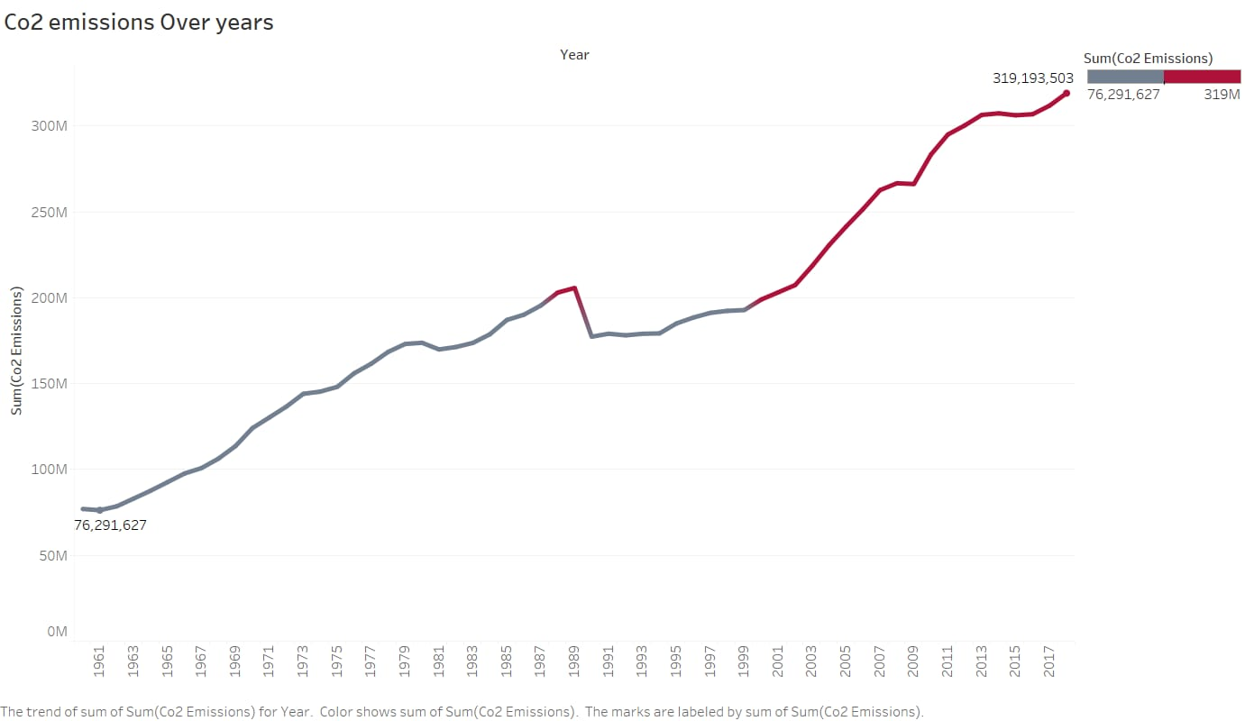
CO2 emission trend – Global

Slide 6
Problem Statement
What we plan to find
Given the current rate of increase in greenhouse gas emissions, by what percentage would CO2 and Methane gas emissions increase by the year 2035?
Does the predicted value go beyond the unacceptable level of CO2 (1000-2000ppm) and Methane (above 5000 ppm) gas amount in the atmosphere?

Slide 7
Data Source and Description
Data Source: Global Monitoring Laboratory Earth System Research Laboratories
The first dataset is Trends in CO2 global which show average carbon dioxide from 1980 to 2022
The second dataset is Trends in CH4 global which show the average methane from 1983 to 2021

Slide 8
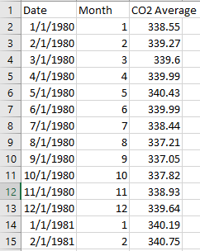
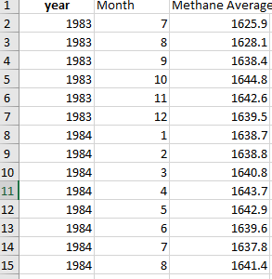
Sample Data for CO2 and Methane

Slide 9
Time Series Forecasting
Time Series Forecasting is the method used in machine learning to predict a particular data, where we are not aware of actual data for a future period
Two different techniques used to do forecasting here
ARIMA - Auto Regressive Integrated Moving Average
ETS - Exponential Triple Smoothing

Slide 10
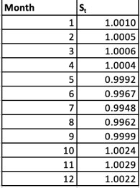
ARIMA Method
Non-seasonal model which is a combination of autoregression and a moving average model
Steps:
Find Moving Average
Determine Seasonality value
Deseasonalize data
Calculate trend value – using Single Linear Regression
Forecast emission value – using Trend and Seasonality
Here Seasonality value is 12, one for each month

Slide 11
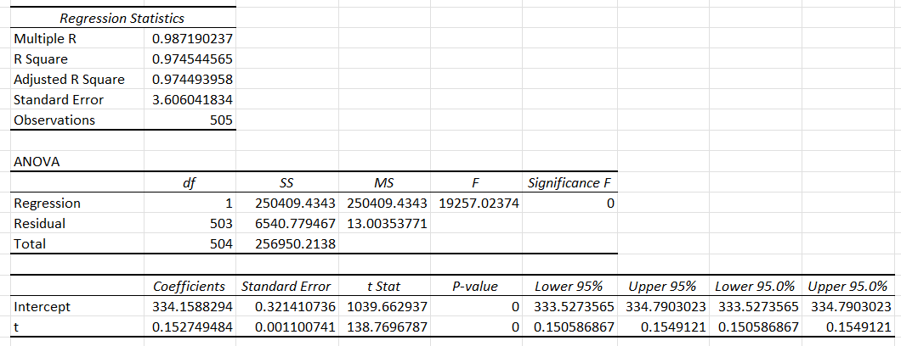
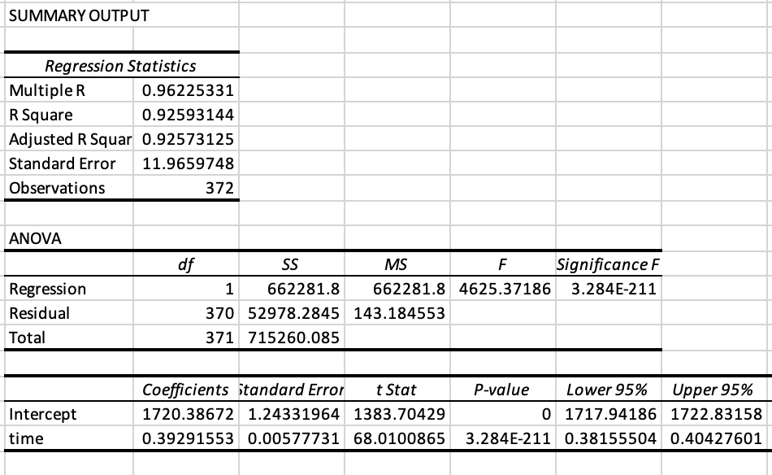
Regression Output
<--- Trend value regression for CO2 gas
Trend value regression for Methane gas --->

Slide 12
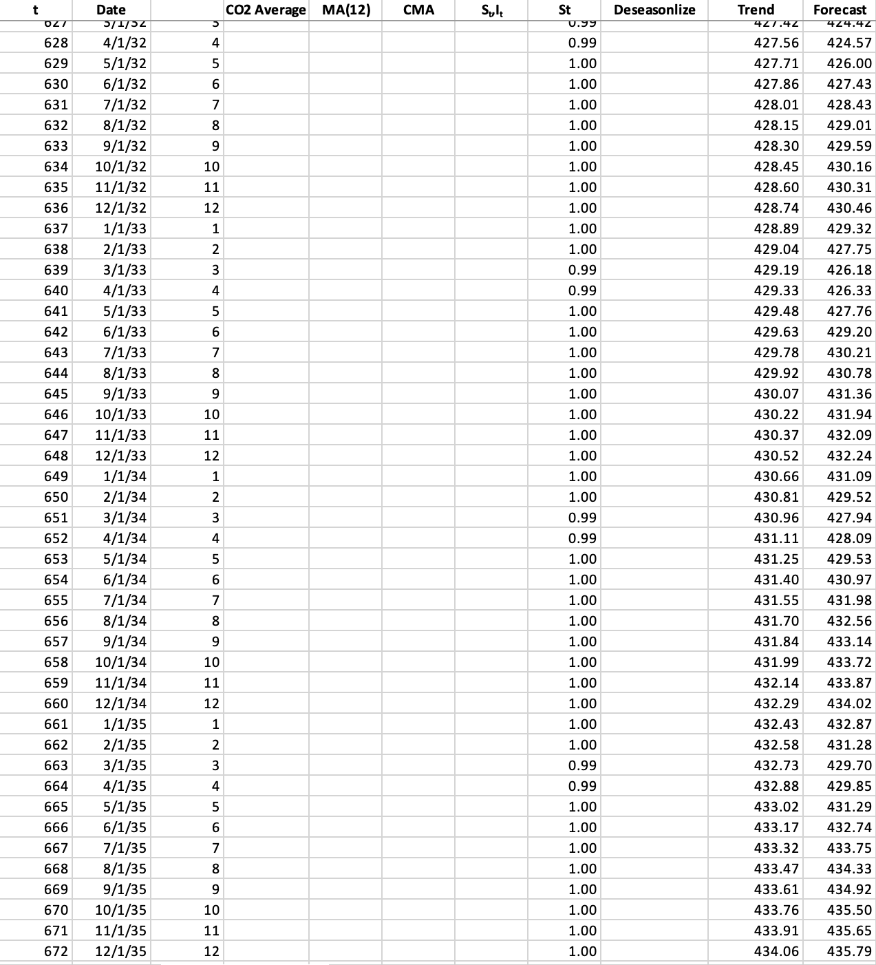
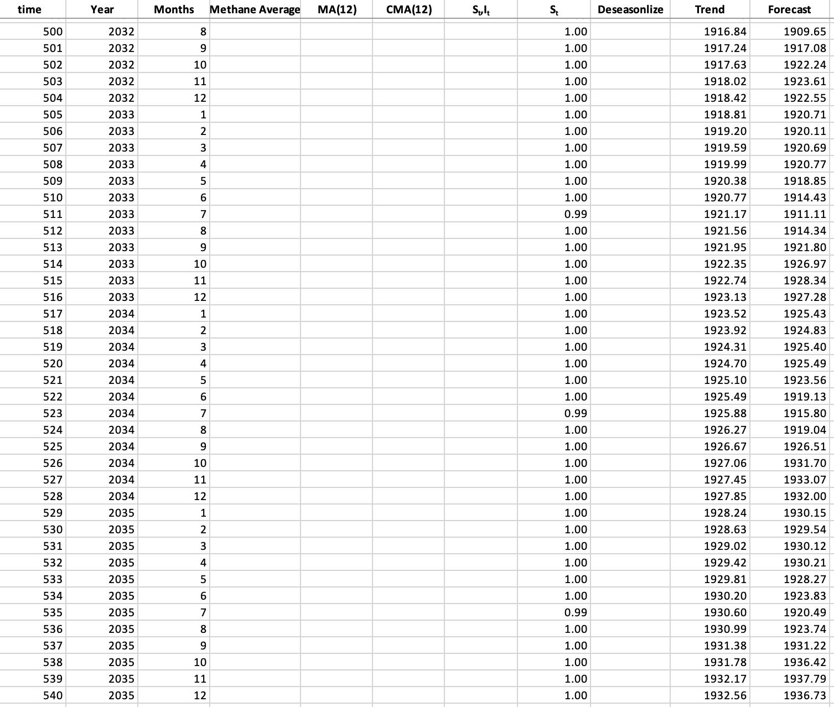
ARIMA – Predicted Final output sample for CO2 and Methane

Slide 13
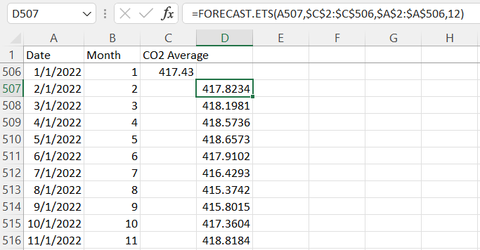
ETS Method
Non-stationary technique which considers the error, trend and seasonality components of data
For ETS forecasting method, in-built excel formula is used
FORECAST.ETS(target_date, values, timeline, [seasonality],
[data_completion], [aggregation])

Slide 14
Model Evaluation Metrics calculation
Gas / Metric | RMSE | MAPE
CO2 - ARIMA | 0.028184408 | 0.525000476
CO2 - ETS | 0.21 | 4.60
Methane - ARIMA | 0.075771161 | 0.538953342
Methane - ETS | 2.47 | 1.926414077
Based on the metrics RMSE and MAPE, it seems like for our data the ARIMA method works well compared to the ETS method

Slide 15
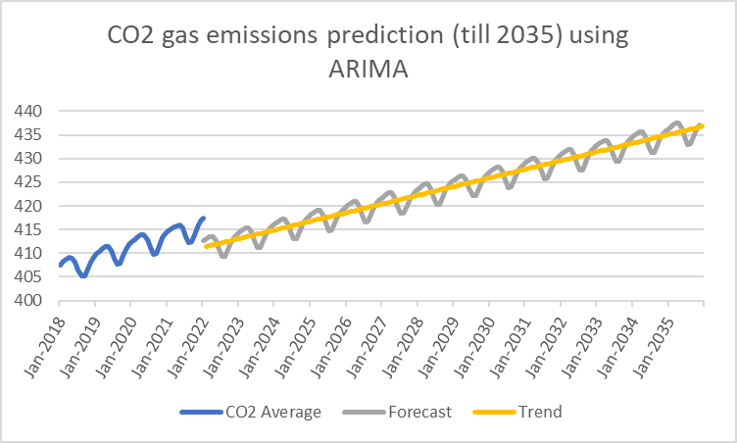
Model Evaluation Evaluation CO2 gas Prediction using ARIMA Method

Slide 16
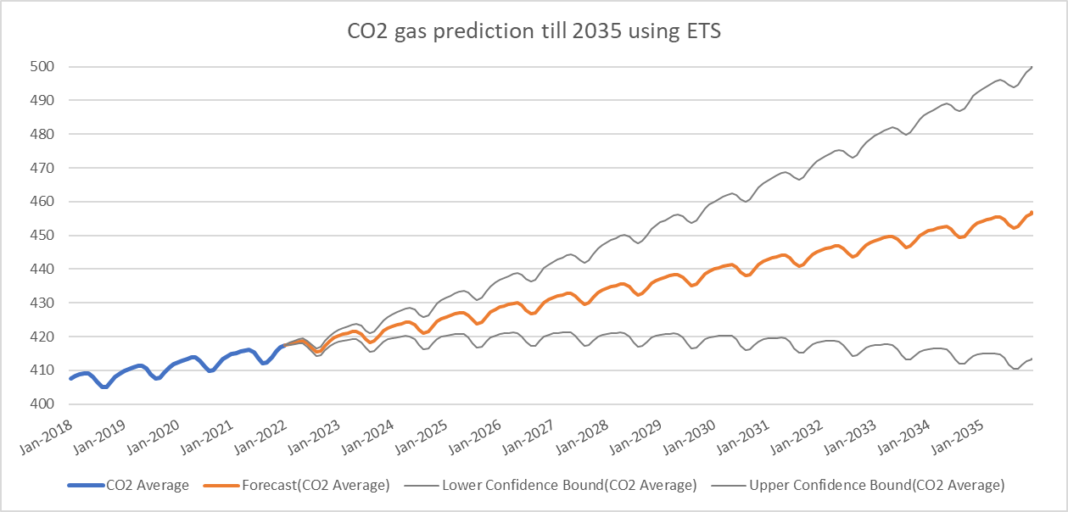
Model Evaluation Evaluation CO2 gas Prediction using ETS method

Slide 17
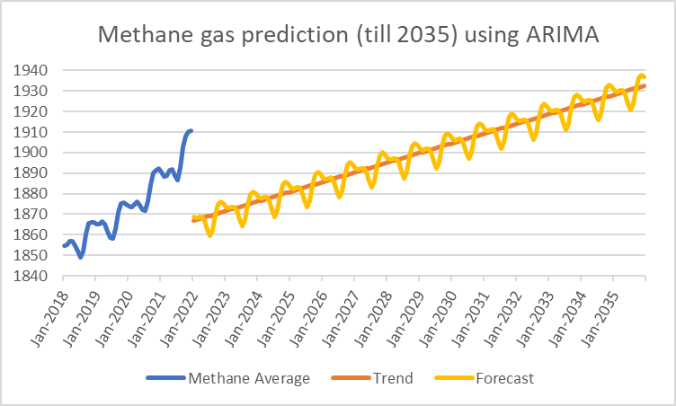
Model Evaluation Evaluation Methane gas prediction using ARIMA

Slide 18
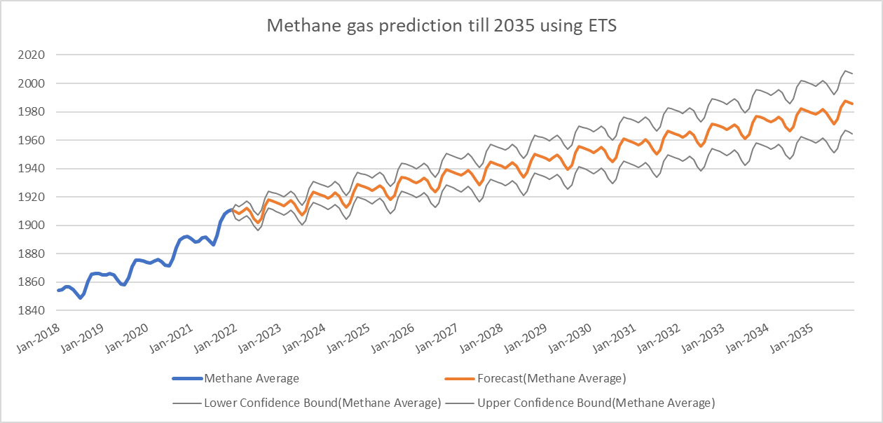
Model Evaluation Evaluation Methane gas Prediction using ETS method

Slide 19
Results
For CO2 gas:
437 ppm by 2035
Increase by 4.7% from present
By 2073, 500ppm is expected to reach
For Methane gas:
1936 ppm by 2035
Increase by 1.3% from present
By 2068, 2000ppm is expected to reach

Slide 20
Recommendations
Predict using seasonal model like SARIMA
predicting more greenhouse gases similar to our project, will lead us predict global temperature accurately
Consider factors like Covid, industrial pollution, cement emissions, electricity waste to predict more accurate values.

Slide 21
THANK YOU !

